Slide 1
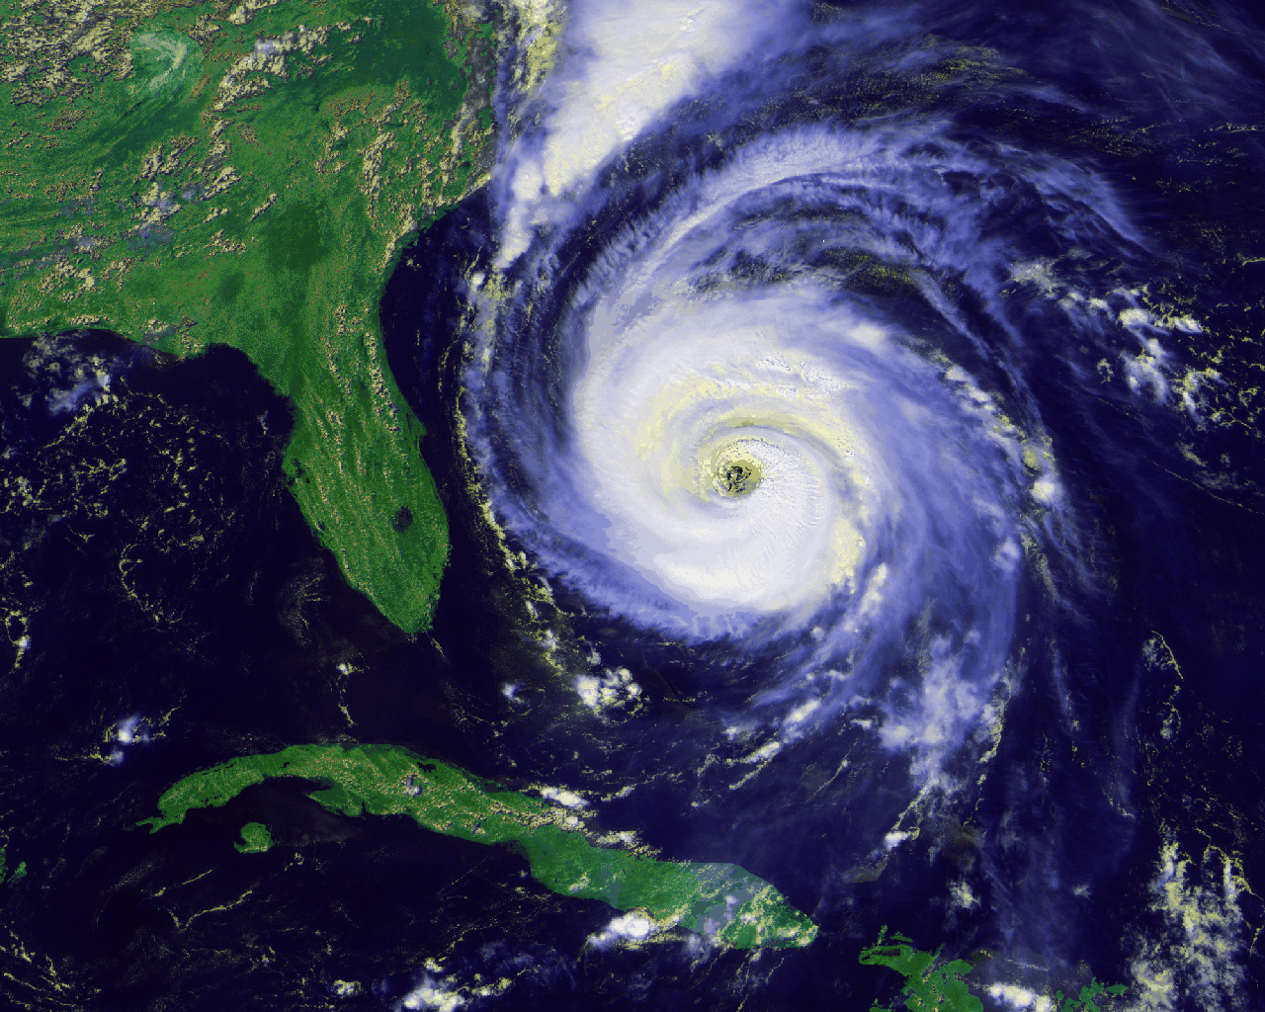
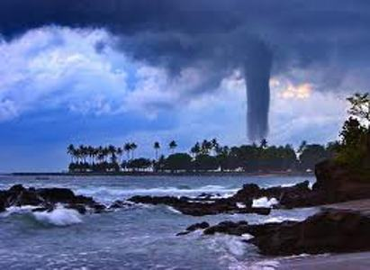
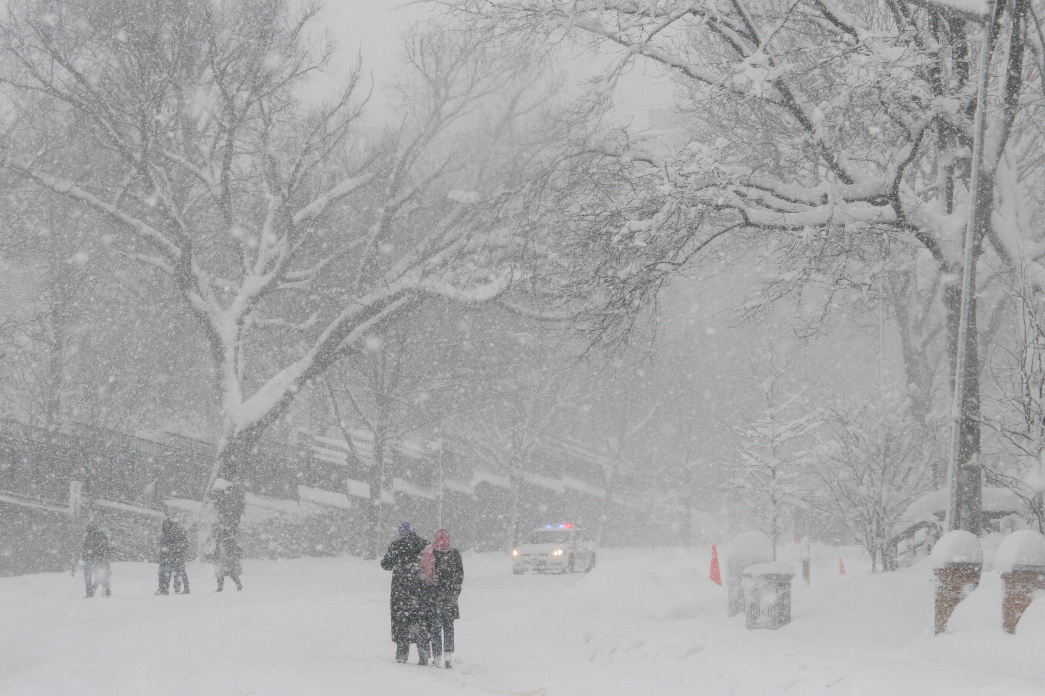
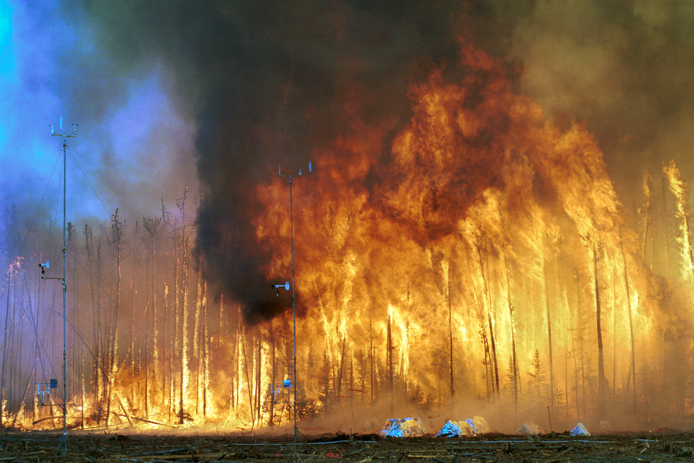
Emergency Preparedness for Pharmacies/Hospitals
Presented by Leslie Feuerbacher CPhT
Pharmacy Inventory management Technician/Buyer

Slide 2
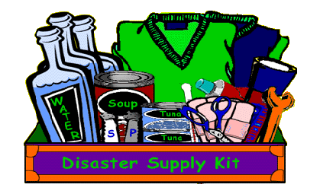
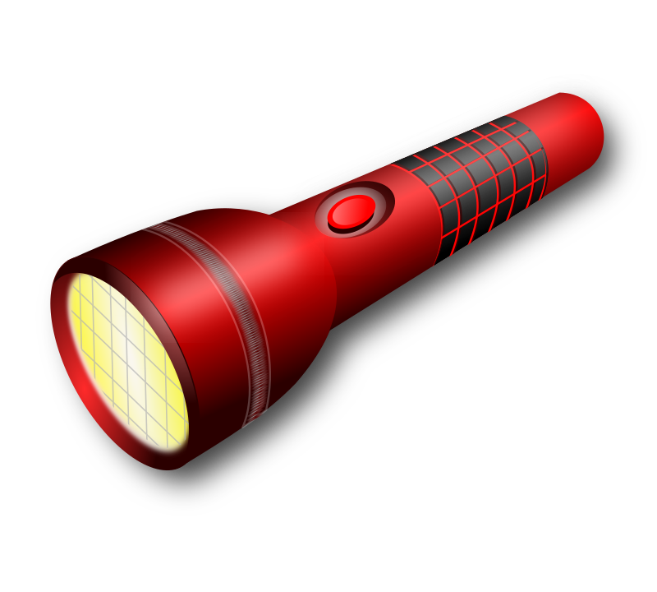
Learning Objectives
Describe at least 4 types of Emergency situations in a Hospital Pharmacy setting.
Identify responsibilities for the Pharmacy Team.
Explain your role as a Pharmacy Purchaser during an Emergency.
List tools and resources available to help during an Emergency situation.

Slide 3
?
?
?
What is your definition of
an Emergency

Slide 4
e·mer·gen·cy
a serious, unexpected, and often dangerous situation requiring immediate action.
mid 17th century: from medieval Latin emergentia, from Latin emergere ‘arise, bring to light’
Urgent
Urgent

Slide 5
The Joint Commission definition of Emergency: An unexpected or sudden event that significantly disrupts the organization’s ability to provide care, or the environment of care itself, or that results in a sudden significant changed or increased demand for the organization's service. Emergencies can be either human-made or natural or a combination of both, and they exist on a continuum of severity.

Slide 6
Which Event Does Not lead to an emergency?
Pre-Test
A. Bio-terrorism
B. Violent crime
C. Water Contamination
D. Running out of labels
E. Natural disaster

Slide 7
What are the responsibilities of the Pharmacy Purchaser during an Emergency? (more than one answer)
A. Report to the command center
B. Place medication order
C. Transport medications to departments
D. Conduct inventory counts on supplies/medications
E. Verify vendor contact information is accurate

Slide 8
The responsibilities of a Pharmacy Team during an Emergency are? (more than one answer)
A. Communication with staff/departments
B. Contact Poison control
C. Pick up Strategic National Stockpile
D. Refer to Policies and Procedures for specific emergency
E. Call the President of the USA

Slide 9
What tools and resources can you use when preparing for emergencies? (more than one answer)
A. The Center for Disease Control
B. CIA
C. Joint commission
D. Weather reports
E. Cms

Slide 10
Emergency situations experienced
during my career as a Pharmacy Purchaser:
Hurricanes Charley, Frances, and Jeanne 2004
Groundhog Day Tornados February 2007
Blue Rhino Plant explosion July 2013

Slide 11
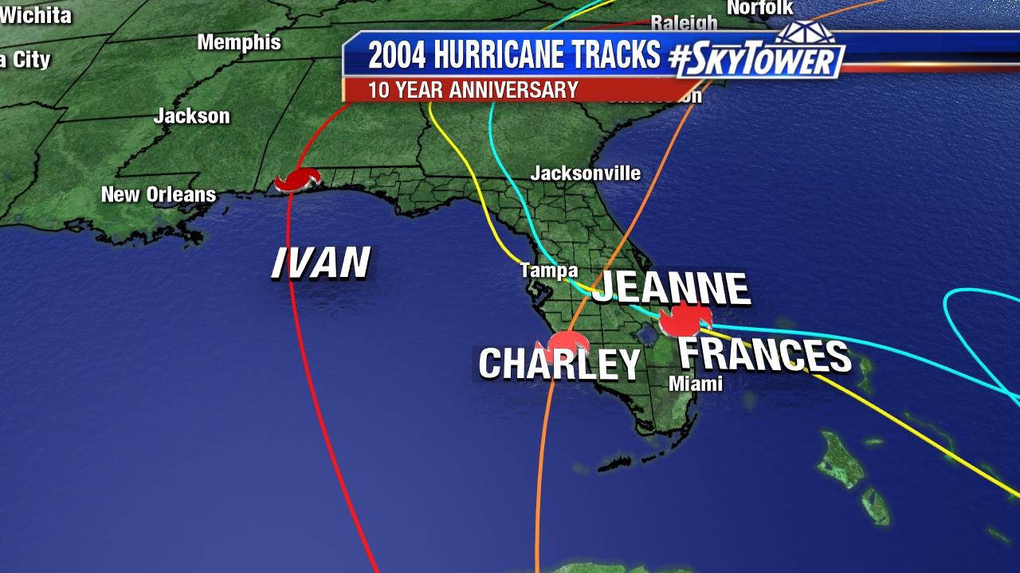
Pictures and examples of natural disaster

Slide 12
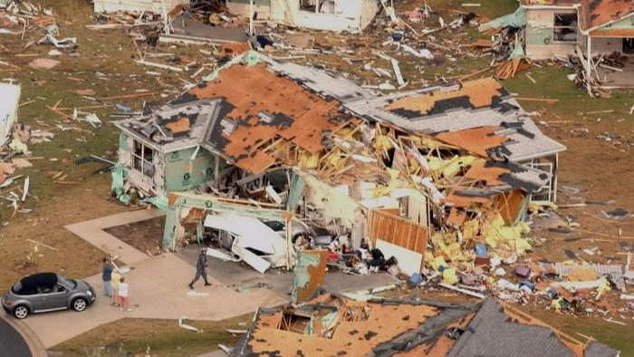
Groundhog Day Tornadoes 2007 destruction in The Villages, Florida

Slide 13
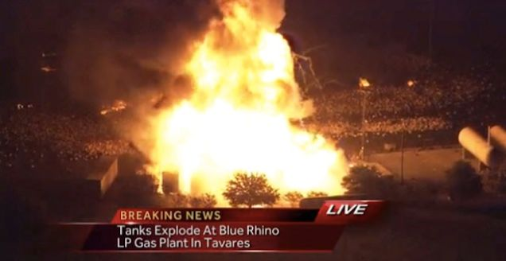
The Blue Rhino Plant explosion

Slide 14
Some natural types of emergency's are…
Dust Storm
Hurricanes
Tornados
Floods
Blizzards
Heat Wave

Slide 15
Some human made
emergencies are…
Fires
Explosions
Transportation accidents
Oil spills
Pollution

Slide 16
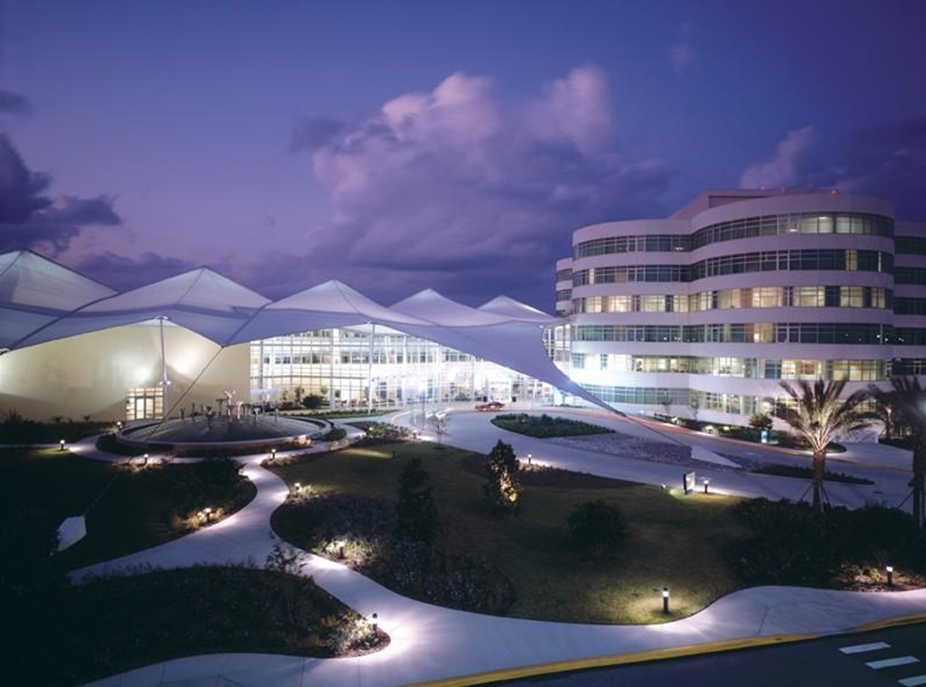
Emergency Preparedness
Safety Station
Emergency Codes and Preparedness Resources
Presented by
Florida Hospital Waterman

Slide 17
Drills
Practice, Practice, Practice
Check inventory of supplies needed for the specific emergency
Pharmacy staff present at the location of triage
Communication and training are crucial for positive outcomes
Learn from your mistakes

Slide 18
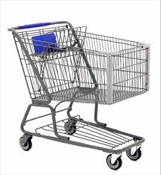
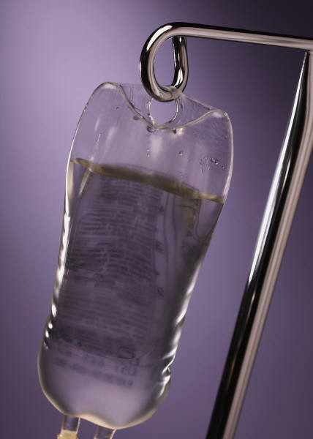
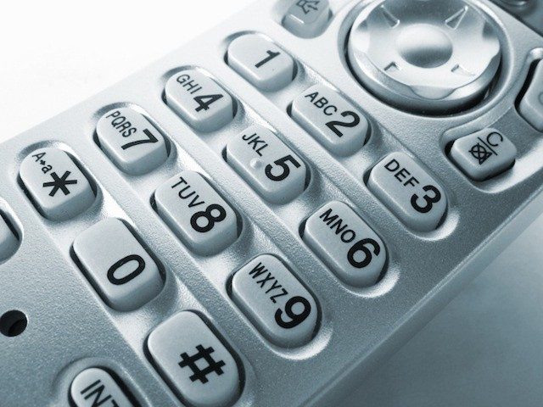
What are some important things needed during an Emergency?

Slide 19
What’s in your Inventory? The 4 Knows… Know your medication stock Know your Supplies Know how to order Know Your local Resources

Slide 20
Items of importance Before an Emergency occurs
Contacts
List of drugs/supply
Extra Support
List of staff with current phone numbers
suppliers and the vendors emergency plans and Phone numbers
Local Hospitals Phone numbers and contacts
Inventory of IV solutions
Insulin, Anti-venom, and vaccines
Carts for transport
Standard operating procedure for ordering of Medications and supplies
Signed agreements with state/county emergency agencies and local hospitals if available

Slide 21
New requirements for CMS
CMS requires facilities to conduct 2 major drills per year. If an emergency presents itself that would satisfy one testing drill needed. The rule requests that facilities ensure vendors have a plan to provide supply source during times of emergency. The needs for staff and patients will be provided provisions to include but not limited to; food, water, medical supplies, and pharmaceutical supplies.

Slide 22
New requirements for CMS continued
The training and exercise requirements of the regulation call for individual-facility and/or full-scale Regional exercises, the below are some examples of exercise considerations:
• Earthquakes • Infectious Disease Outbreak • Active Shooter
• Single-Facility Disaster (power-outage)
• Medical Surge (i.e. community disaster leading to influx of patients)
• Tornados • Flooding • Cyber Security Attack • Fires • Hurricane

Slide 23
Central Florida Regional Emergency Drill Scenario 4-6-2017:
Anti Government Activity-”Americans for an Armed Society” with Motorcycle groups attending. A Box Truck with stolen Cobalt 60 believed to be in Florida.
Notification of 4 explosions taking place simultaneously in front of Court Houses in Lake, Orange, Osceola, Seminole Counties.

Slide 24
Exercise Day 4/4/2017
Volunteers Register/In place of scenes
Staff for all participating facilities briefed and put on alert
Safety Check before start of exercise
Begin Exercise
Notification of explosions
911 calls received
Command Center established
Communication between 911/Ems/Hospitals
HazMat Alert
Decon set-set up
Triage set-up
Casualties begin arriving

Slide 25
Exercise Day 4/4/2017 cont.
Treatment and decon of patients
Pharmacy Technician dispatched to ER
Pharmacy researching medications needed
Supplies/medications transported to treatment areas
Medical examiner dispatched
Update on causality count
Communication continues
Hospital victims dwindle to worried well
scene is cleared

Slide 26
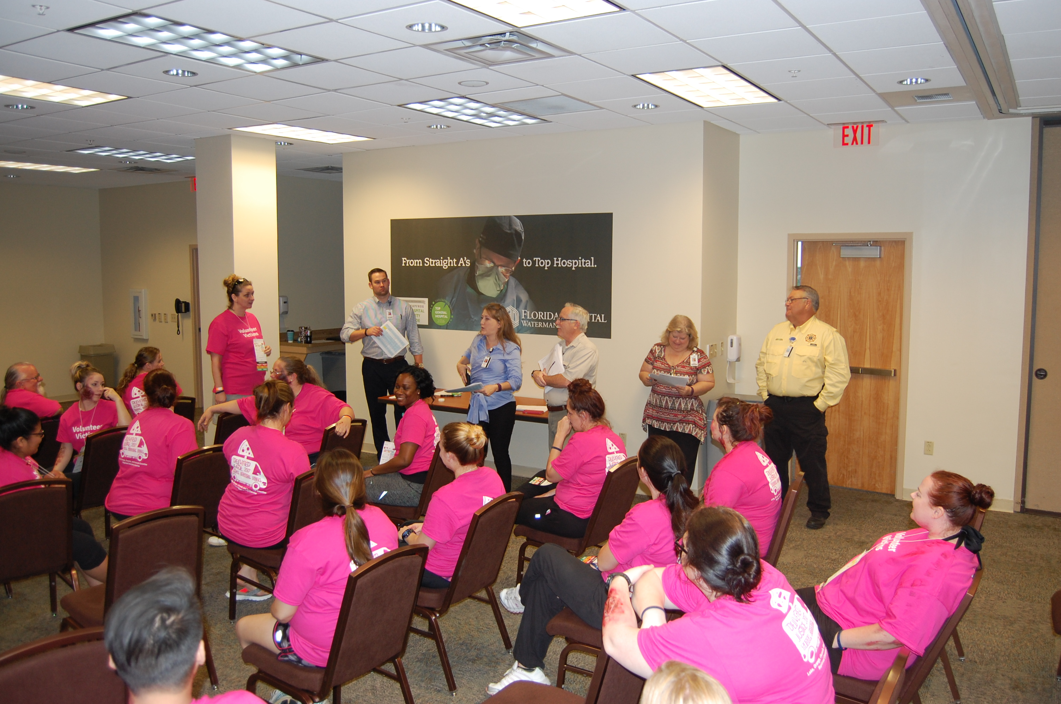
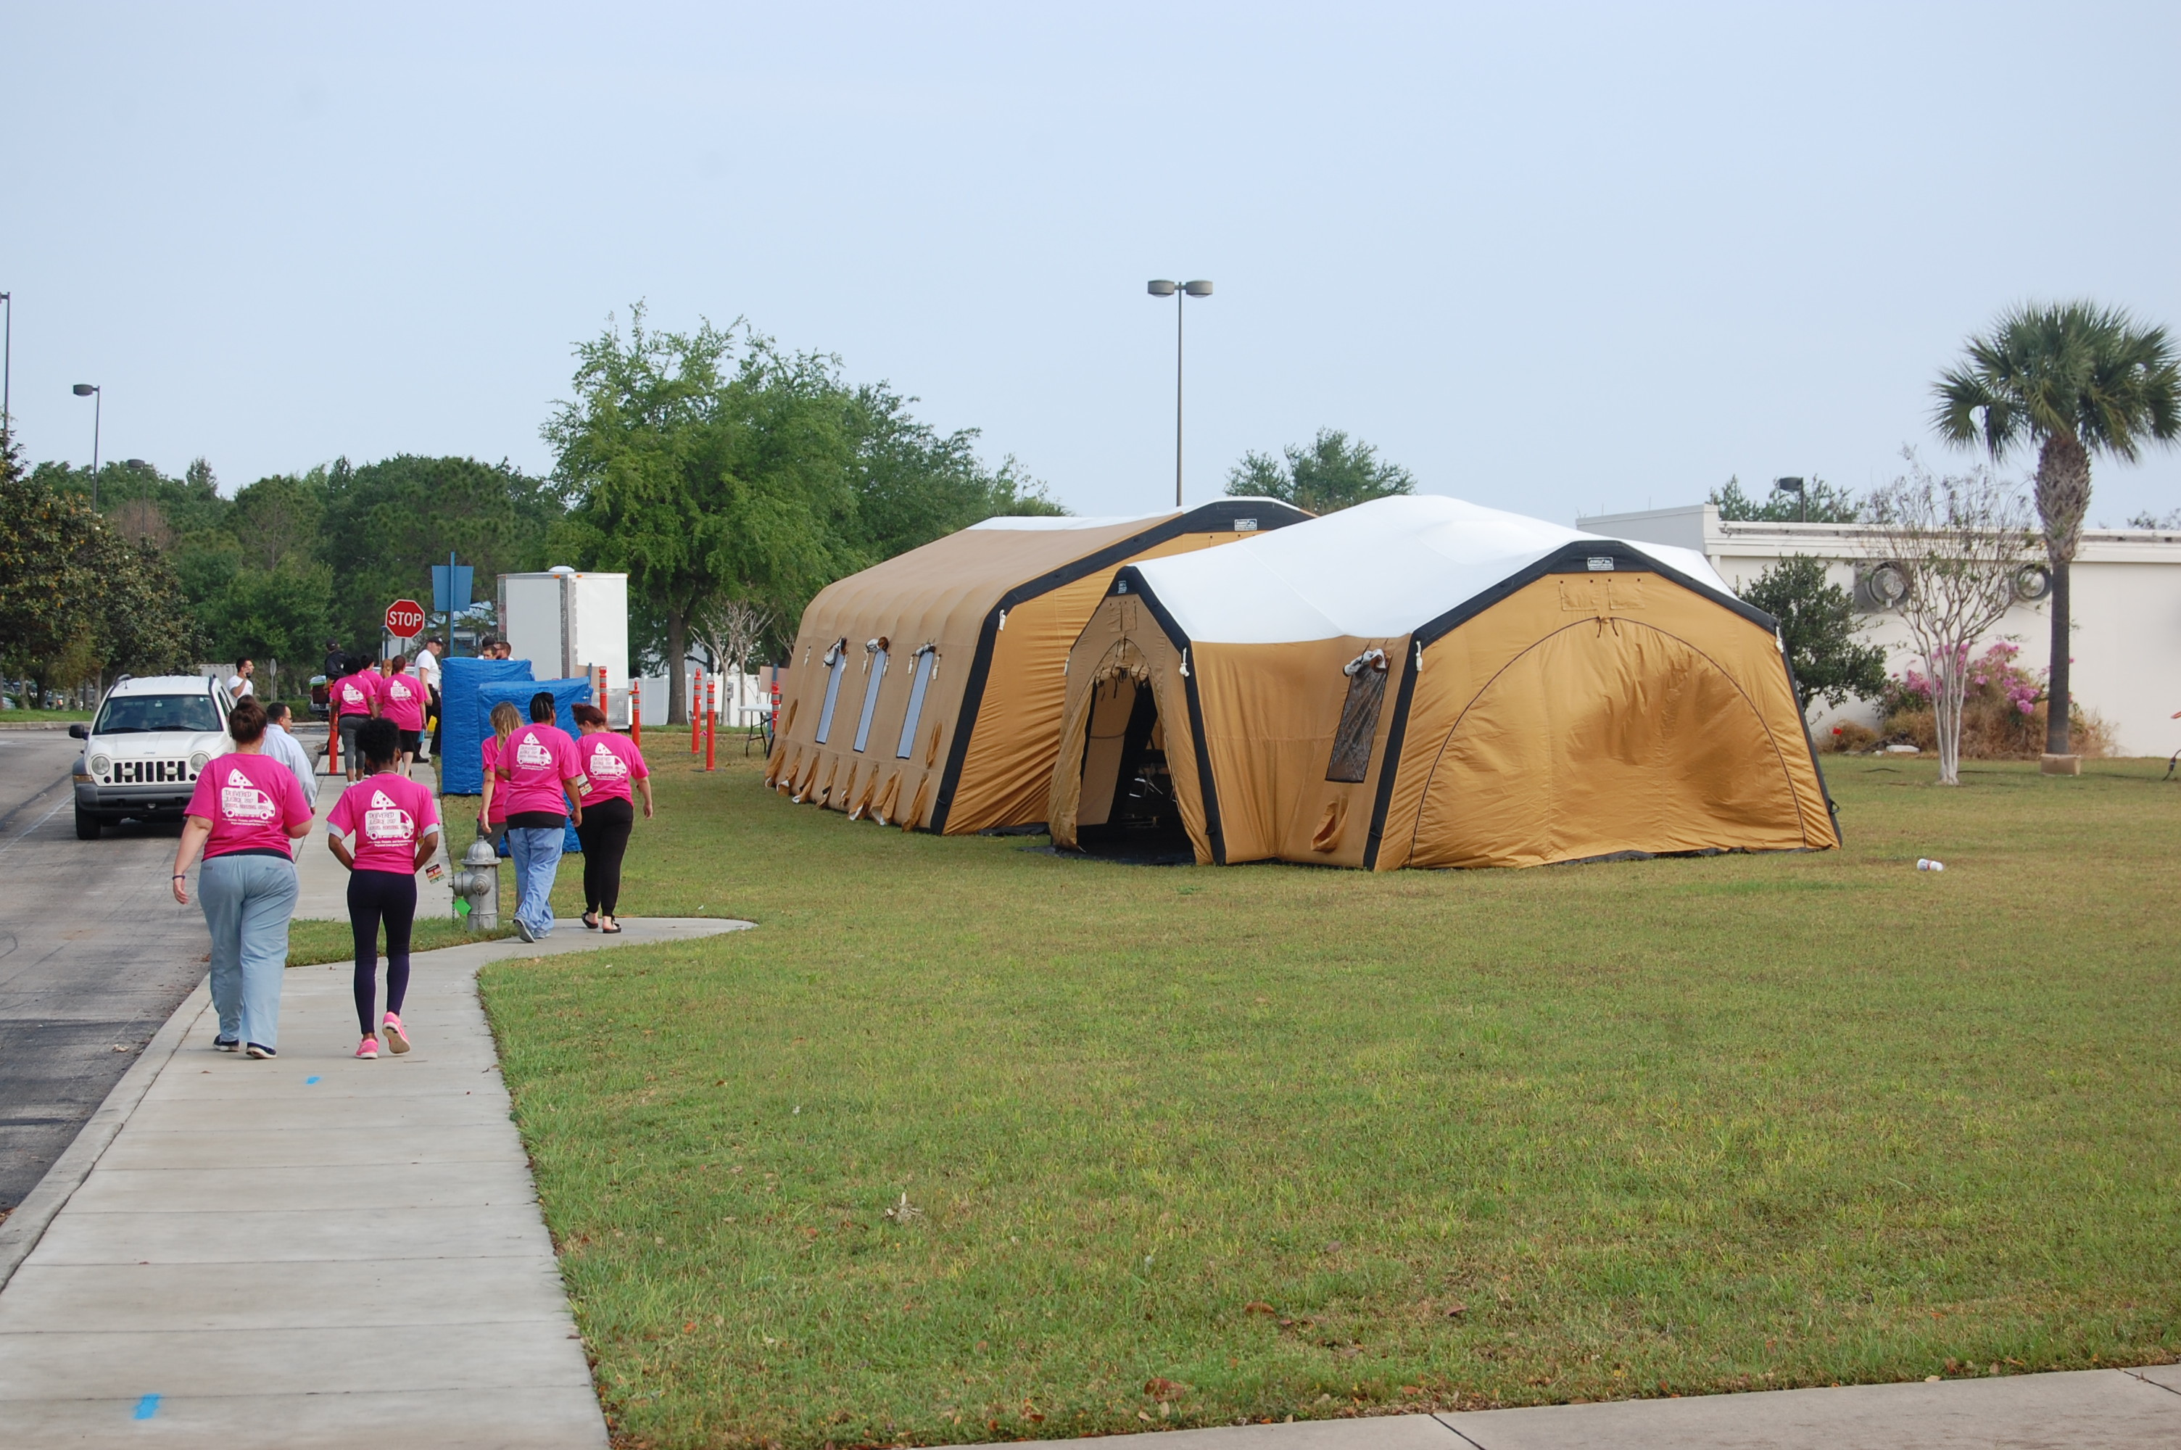

Slide 27
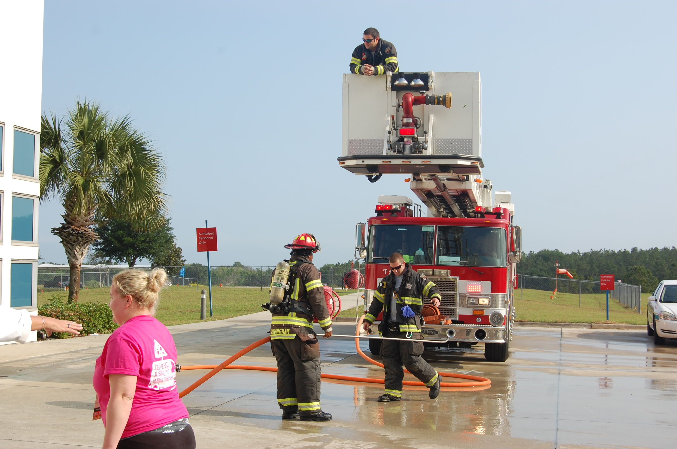
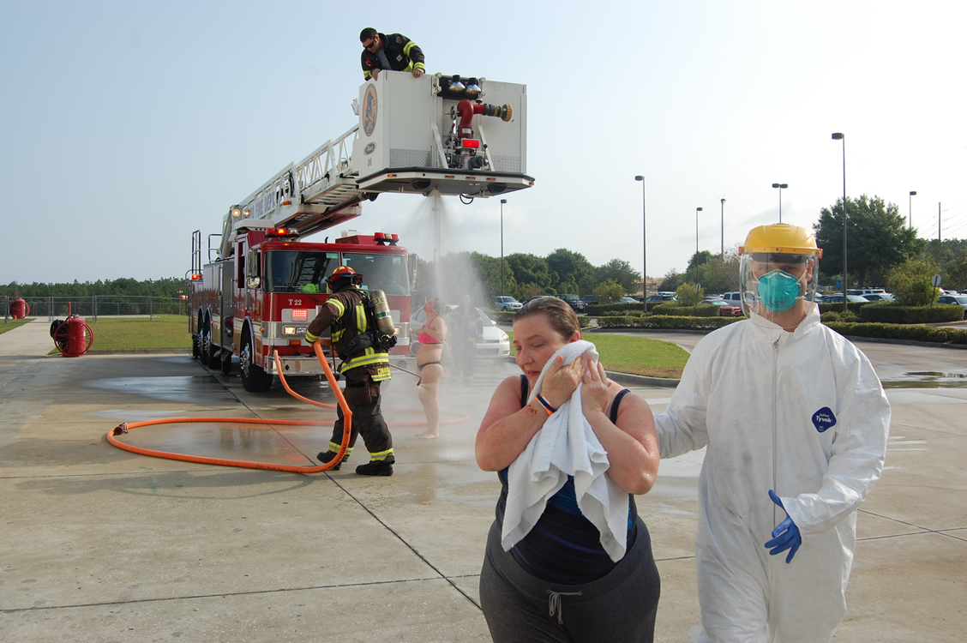

Slide 28
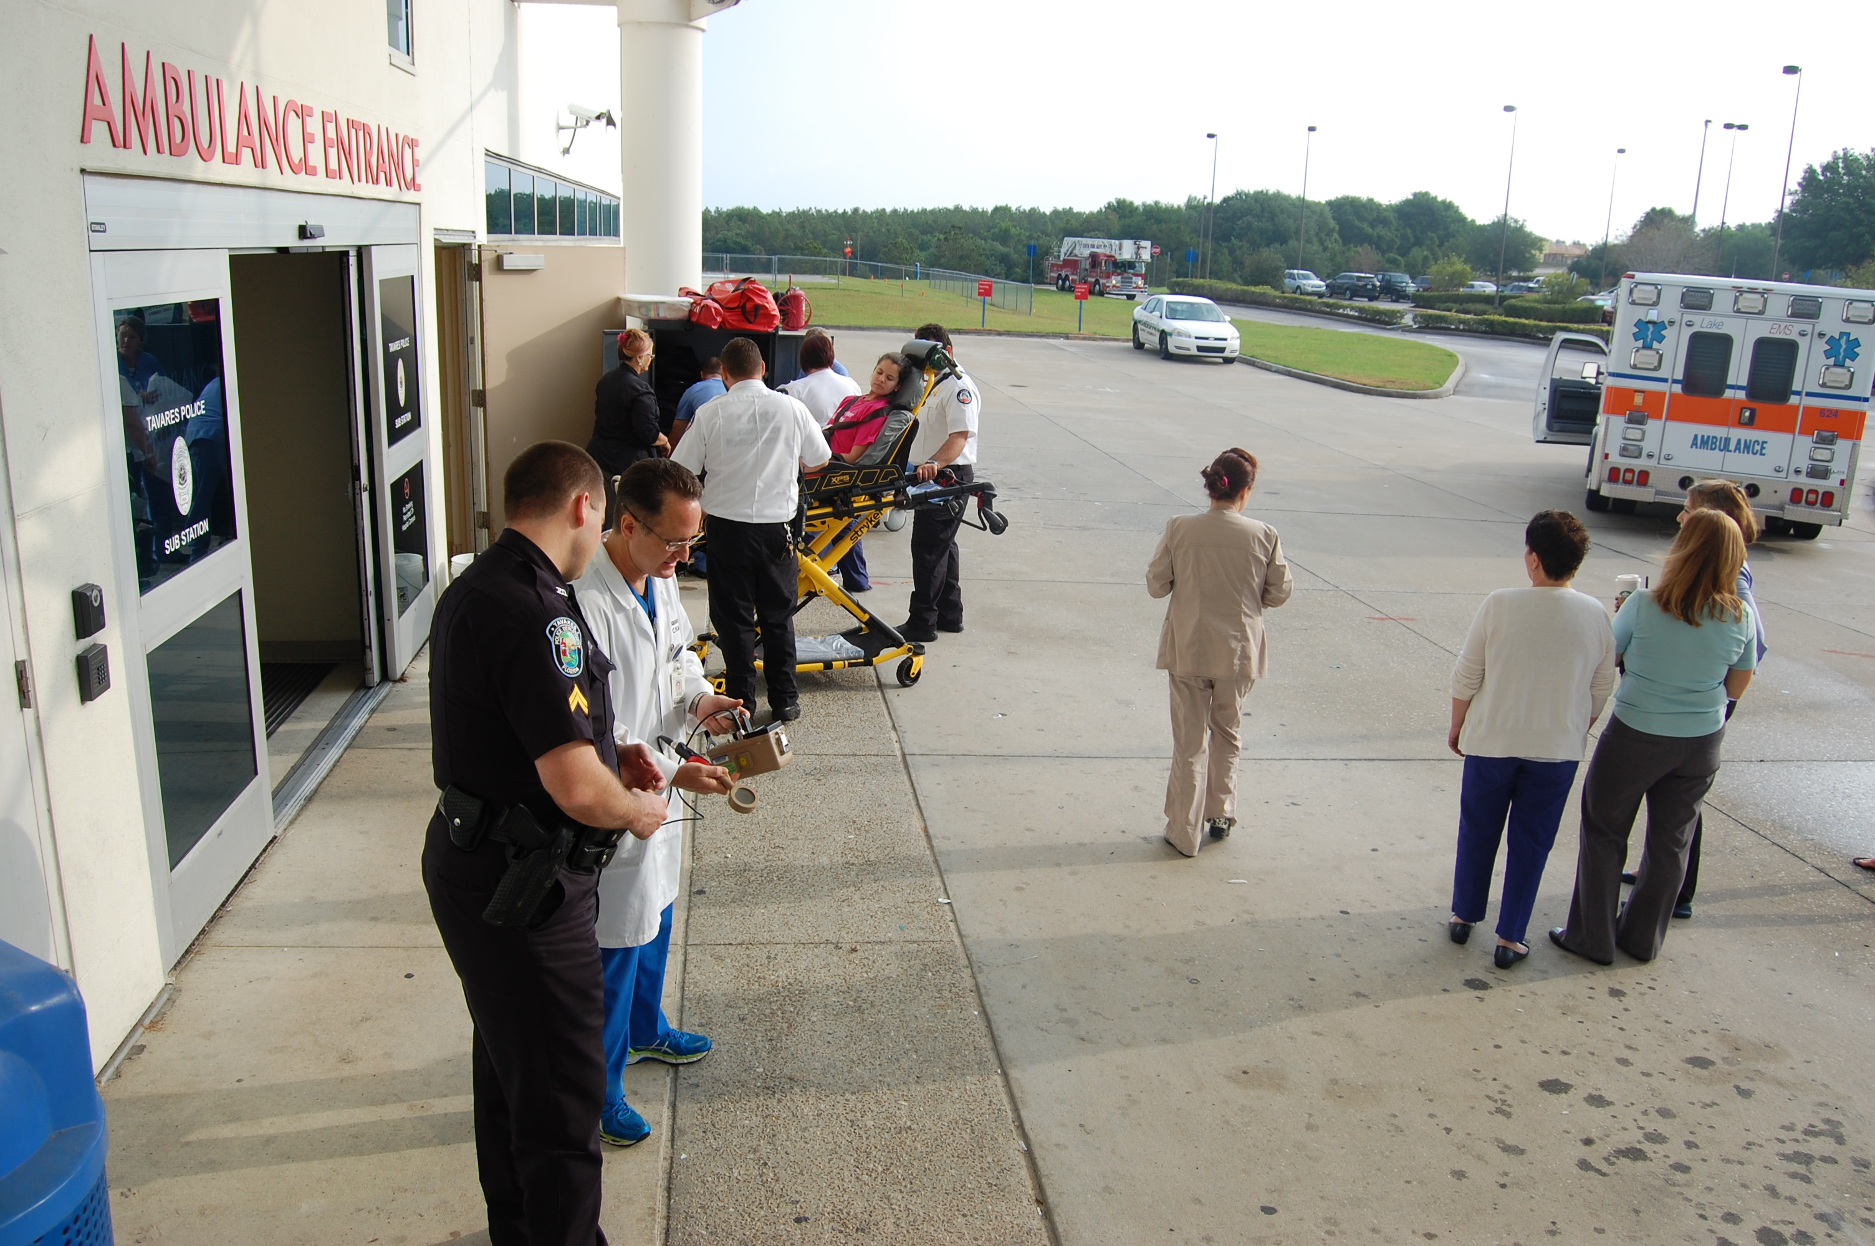
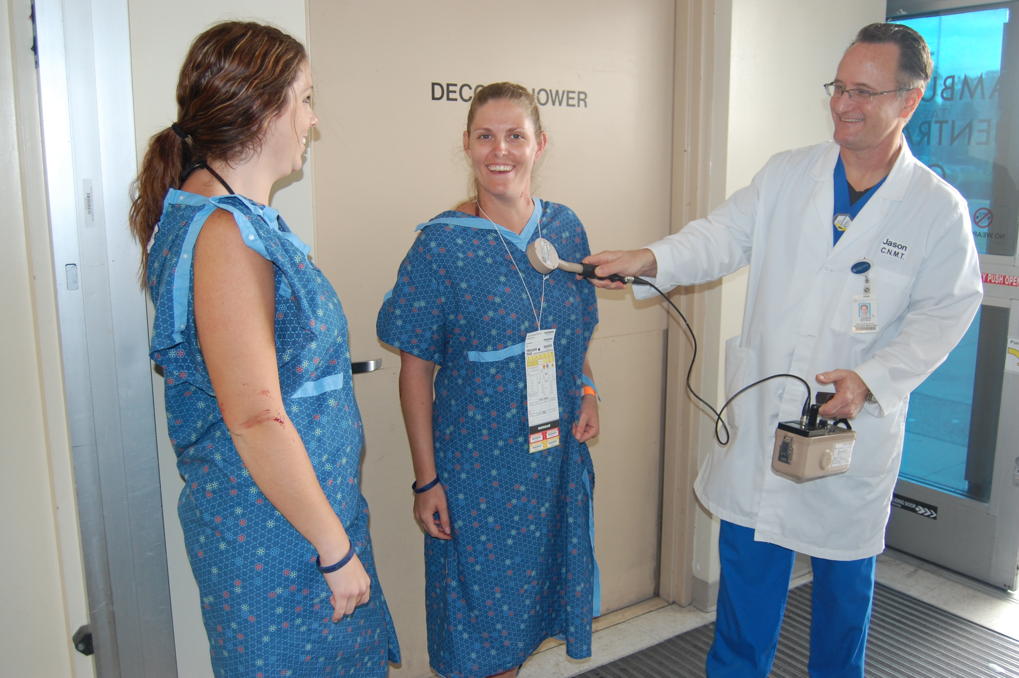

Slide 29
Strategic National Stockpile
Managed by the CDC
National repository of antibiotics, chemical antidotes, antitoxins, life support medications, medical/surgical supplies
Push packs are delivered within 12 hours, but plan to have supplies for 72-96 hours

Slide 30
Memorandum of Understanding Between Lake County Health Department and Florida Hospital Waterman
Purpose of this agreement is to delineate responsibilities of prophylaxis of employees and immediate family members during an event of a catastrophic biological incident.

Slide 32
Pharmacy Team responsibilities
Director Manager RPH Buyer
Techs
Everyone in Pharmacy plays an important part to accomplish the goal of providing the best possible care especially during an emergency.
Many departments have to work together to make sure all aspects of care are provided, such as; Administration, Facilities, Clinical Staff, Pharmacy, Materials Management, Food Services and Security.

Slide 33
Director of Pharmacy Responsibilities
Report to Command Center
Communicate with staff on status of situation
Pick up Push-Packs
Coordinate staffing needs
Contact needed resources

Slide 34
Some responsibilities
for the Pharmacist are…
Distribute medications during event
Research medications needed for appropriate situation
Patient counseling if needed

Slide 35
Some responsibilities for the Pharmacy Buyer are…
Placing orders
Assisting with calls
Inventory reports
Refrigeration space management
Filling orders

Slide 36
Tools and Resources

Slide 37
List of Websites for resources:
www.cms.gov
www.cdc.gov
www.nrt.gov
www.jointcommission.org
www.poison.org

Slide 38
Which Event Does Not lead to an emergency?
Post-Test
A. Bio-terrorism
B. Violent crime
C. Water Contamination
D. Running out of labels
E. Natural disaster

Slide 39
What are the responsibilities of the Pharmacy Purchaser during an Emergency? (more than one answer)
A. Report to the command center
B. Place medication order
C. Transport medications to departments
D. Conduct inventory counts on supplies/medications
E. Verify vendor contact information is accurate

Slide 40
The responsibilities of a Pharmacy Team during an Emergency are? (more than one answer)
A. Communication with staff/departments
B. Contact Poison control
C. Pick up Strategic National Stockpile
D. Refer to Policies and Procedures for specific emergency
E. Call the President of the USA

Slide 41
What tools and resources can you use when preparing for emergencies? (more than one answer)
A. The Center for Disease Control
B. CIA
C. Joint commission
D. Weather reports
E. Cms

Slide 42
Questions

Slide 43
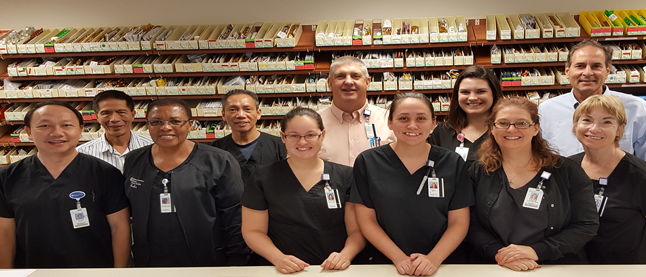
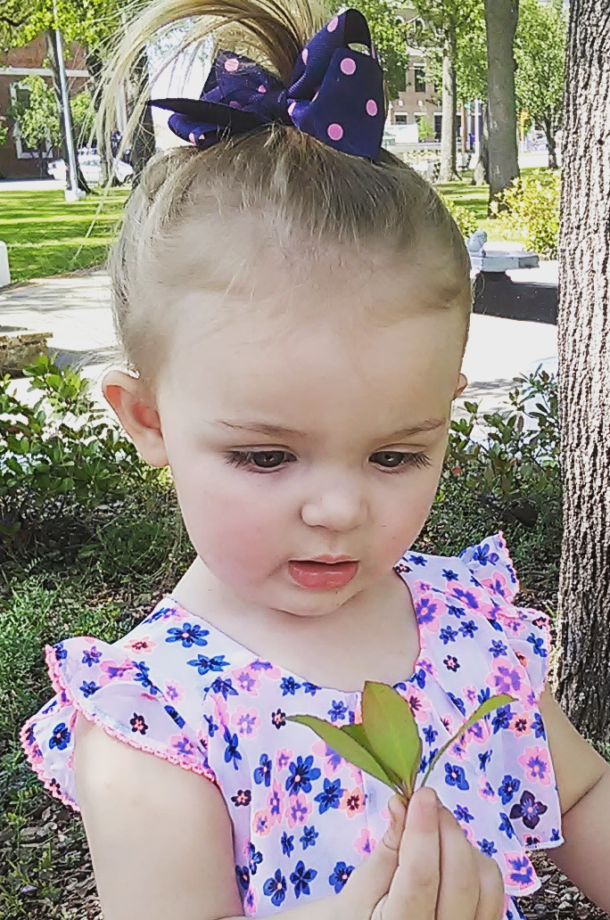
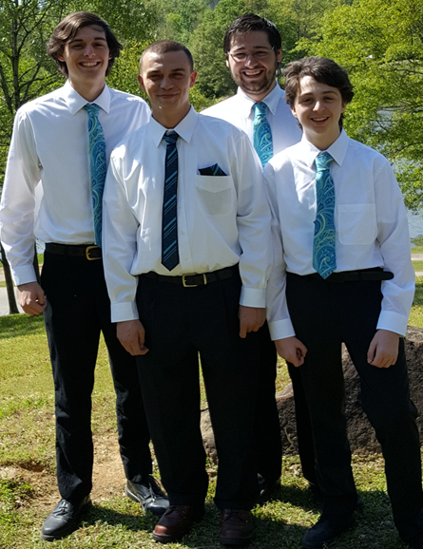
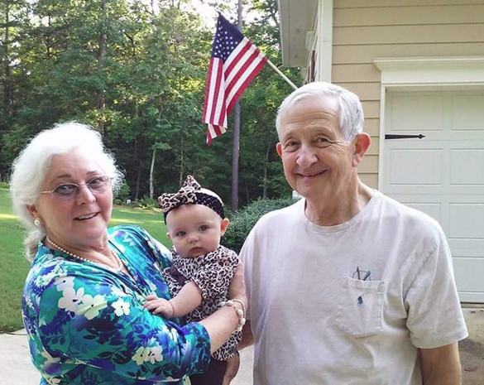
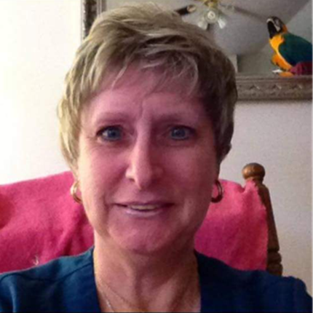
This is why you should be prepared for emergencies!

Slide 44
Thank you and have a safe trip home!

